Slide 1
BIOM 7110/8110 BIOSTATISTICS
Erno Lindner, Ph.D. (elindner@memphis.edu)
Amber Jennings, Ph.D. (jjnnings@memphis.edu)
M,W: 8:40-10:05
umdrive/elindner/public/biostatistics

Slide 2
Distributions
The results of 600 rolls with one dice
The results of 500 rolls with two dice
The results of 100 titrations
The results of rolling 6 dice 600 times
How to summarize data?
The goal is
to get descriptive information about the population
to test a hypothesis about the population

Slide 3
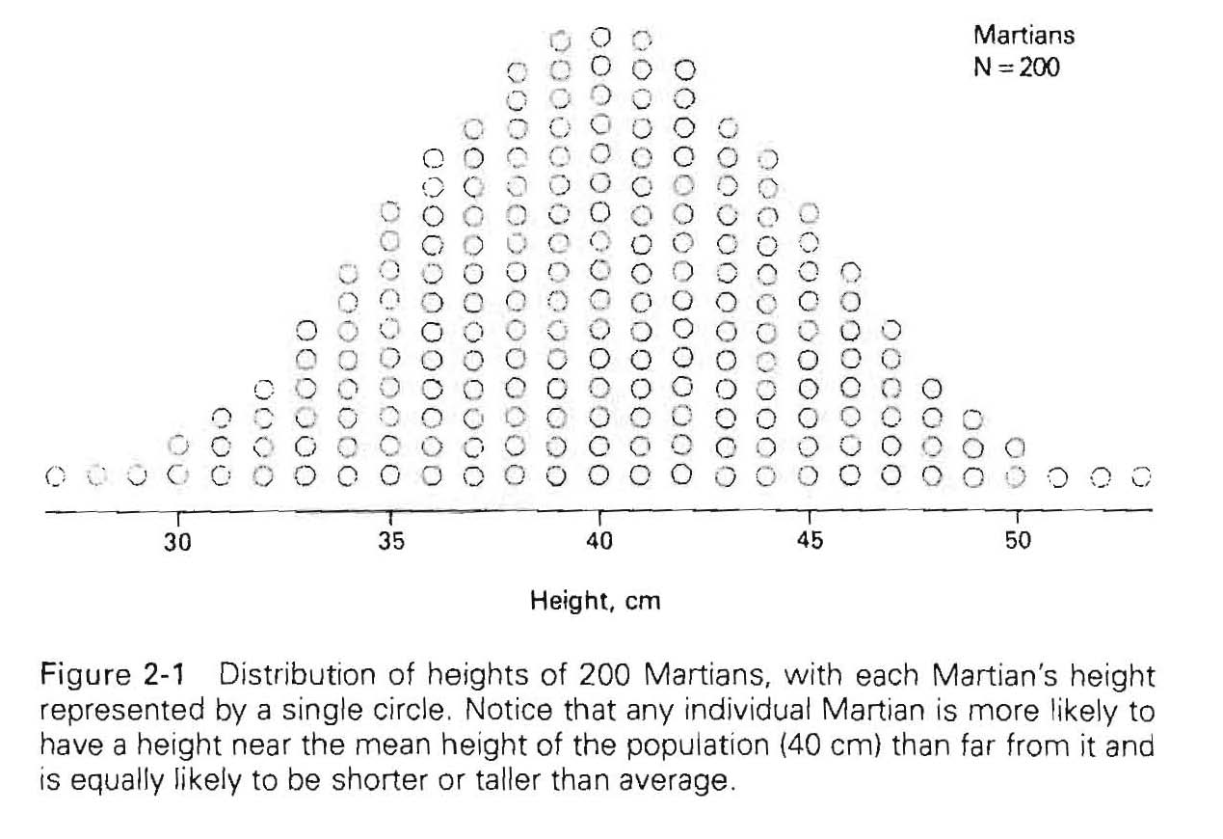
Terminology and nomenclature
A descriptive measure (describing some characteristics) of a population is called a parameter
A descriptive measure (describing some characteristics) of a sample is a statistics

Slide 4
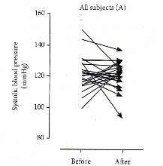
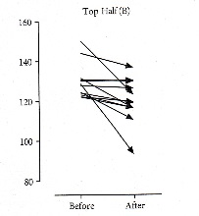
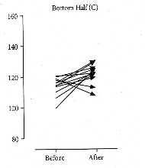
The values of a variable tend to cluster, i.e., a new value is more likely will fall near the mean than far from it and equally likely above or below it. This property termed as central tendency
We are fooled by the regression to the mean
Simulated blood pressure data before and after treatment
All data
High BP data
Low BP data
The Mean: is an arithmetic average and it is the most common measurement of central tendency when the data are measured on an interval or ratio scale.
Population mean Sample mean
Note: Extreme outliers in the sample can exert a large effect of the mean

Slide 5

Geometric mean
Weighted mean
$$={10}^{\frac{\sum_{i=1}^{n}{logx_{i}}}{n}}$$
Example GPA calculations
Grade | Grade value (x) | # of credits (f) | Grade points (fx)
A | 4 | 12 | 48
B | 3 | 18 | 54
C | 2 | 12 | 24
D | 1 | 4 | 4
F | 0 | 4 | 0

Slide 6
Population parameters / Sample statistics derived from the SS
Population Sample
Variance
Standard deviation
Coefficient of variation (relative standard deviation)
Note: Divided by (n-1)

Slide 7
To characterize the variability of the data within a distribution:
Sum of deviations:
Average of absolute deviations:
Sum of squares
SS in EXCEL
 | x | x²
 | 3 | 9
 | 4 | 16
 | 5 | 25
 | 3 | 9
 | 5 | 25
 | 4 | 16
 | 6 | 36
 | 2 | 4
 | 4 | 16
 | 5 | 25
SUM | 41 | 181

Slide 8
A descriptive measures
min & max
Average (mean)
Median
Mode
Quartiles
Range of the middle quartile (box diagram)
Variance
Standard deviation
Which of these possibilities can be used or is the most appropriate depends on the data
The standard deviation provides information on the “spreading” of the data which were used to calculate the average.
It is a measure of the average amount by which each observation in a series of observations differs from the mean.

Slide 9
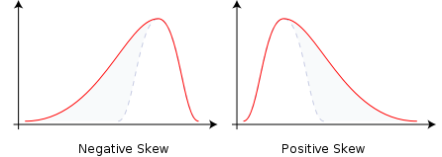
Quantitative Data
Mean value is good for symmetrically distributed values
‘bell shaped curve’
Median values good for skewed or asymetrically distributed values
Life time data, failure rates, fatigue testing
Negative Skew
Positive Skew

Slide 10
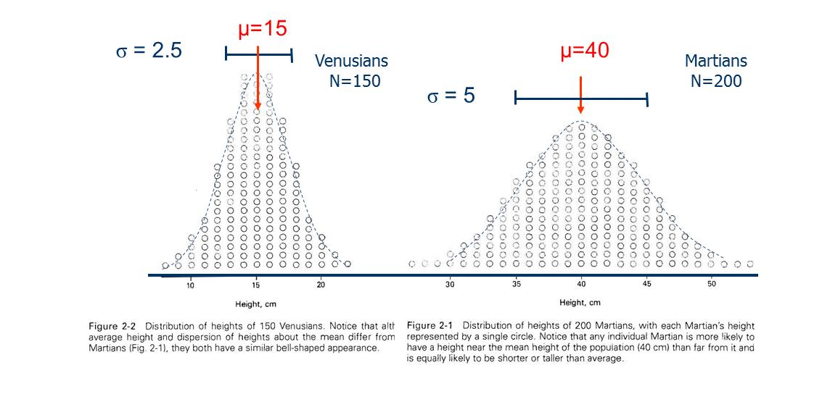
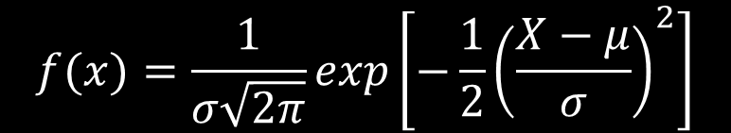
To characterize the location and the variability of a symmetrically distributed data set most commonly the mean and standard deviation are used.
The standard deviation is a measure of the average amount by which each observation in a series differs from the mean.
This pattern is very common when the observed measurement is the sum of many independent random factors
Normal distribution:
Height at a given X
$$f(x)=\frac{1}{σ\sqrt{2π}}exp\left[−\frac{1}{2}{\left(\frac{X−μ}{σ}\right)}^{2}\right]$$

Slide 11
Normal distribution
Population mean, μ (sample mean, x)
Inflection point
Population standard deviation, σ
(sample standard deviation, s)
Mathematically is a bell-shaped curve having inflection points at exactly 1 standard deviation above and below the mean.

Slide 12
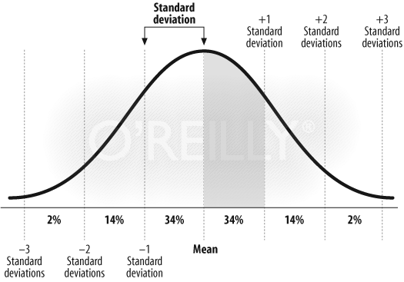
Areas Under the Normal Curve: Empirical rule Empirical Rule for Data with Normal Distribution
68-95-99.7 rule
About 68% of all values fall within 1 standard deviation of the mean
About 95% of all values fall within 2 standard deviations of the mean
About 99.7% of all values fall within 3 standard deviations of the mean
s is preferred over s² since it has the same units as the original measurements
50% of data values fall within ave ± 0.67s
Notes:
12

Slide 13
Different looks of normal distributions
μ = 40, σ = 10
μ = 100, σ = 20
μ = 200, σ = 40
The standard deviation is a measure of the average amount by which each observation in a series differs from the mean.

Slide 14
Some other examples of normal distributions

Slide 15
Using the normal curve
Area under the normal curve at any value along the x-axis represents the percent or probability of that value on the y-axis, it follows that:
Approximately 68% of area under curve falls within range of μ ± σ
P[μ – σ ≤ X ≤ μ + σ] ≈ 0.68
95% of area under curve falls within μ ± 2σ
P[μ – 2σ ≤ X ≤ μ + 2σ] ≈ 0.95
99% of area under curve falls within μ ± 3σ
P[μ – 3σ ≤ X ≤ μ + 3σ] ≈ 0.99

Slide 17
Normal curves
Are theoretical based on idea of infinite number of values
Even modest number of sample values tend to distribute ‘normally’ as long as population is normally distributed
It is a useful model to evaluate data when data’s deviation from normality is small
In statistics terms, normal curve is robust to minor violations of its shape assumptions
In lay terms, we can use percentages or probabilities associated with normal curve to interpret data even when data only approximates normal distribution

Slide 18
Using the Normal Curve & the Empirical Rule
percentages are very important because they form the basis of many statistical methods and will appear over & over through out this course
Although this may seem a paradox, all exact science is dominated by the idea of approximation! (Sir Bertrand Russell)

Slide 19
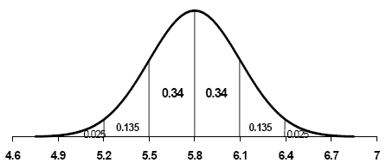
Ex Problem #1 ave hgt males
μ = 5.8
σ = 0.3
Question: What is the total area under the Normal curve ?
Question: Eye-ball the shaded area. What is P [ X > 6.1 ] ?
16%

Slide 20

Example Problem #2
μ = 5.8
σ = 0.3
0.0015

Slide 21
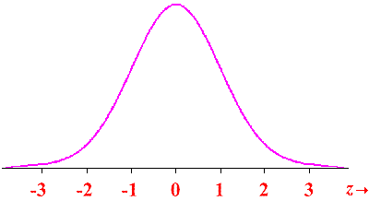

Standard Normal Distribution
Infinite number of normal distributions each defined by μ and σ
Integral calculus required to determine exact P for each distribution
Can use Standard Normal Distribution
Tabulated and based on μ = 0 and σ = 1
Table uses Z to represent range of random variable
Open z-table pdf doc in ecourse
$$z=\frac{x−μ}{σ}$$

Slide 22
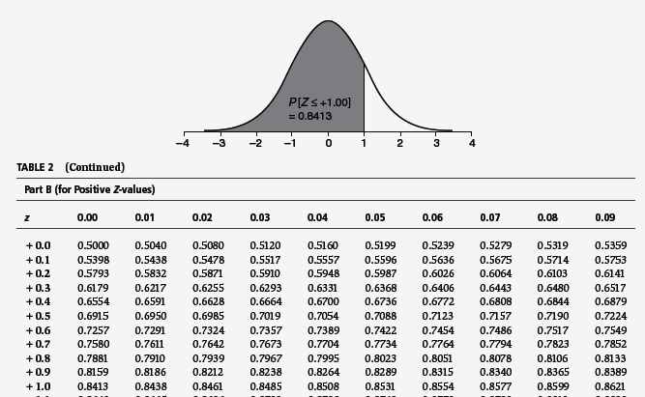
Using the Standard Normal Table

Slide 23
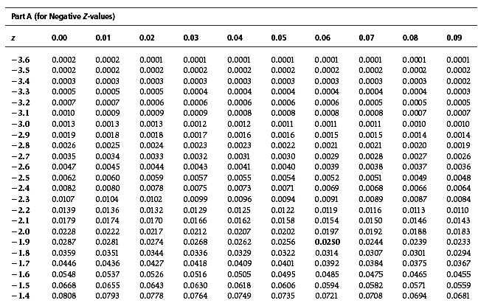
Using the Standard Normal Table
What is P [ Z ≤ −1.78 ] ?

Slide 24
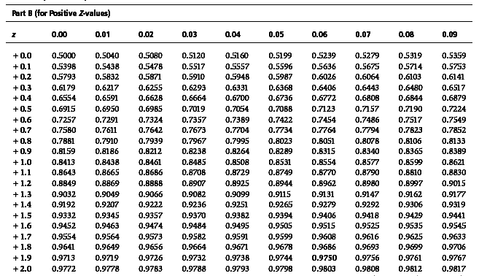
Using the Standard Normal Table
What is P [ Z ≥ +1.78 ] ?
= 1 − 0.9625
= 0.0375
0.9625 ???
0.9625
−3 −2 −1 0 +1 +2 +3

Slide 25
When to use 1-P or P
Draw it out
Does it make sense?
Positive z; looking for more extreme value?

Slide 26
Using Excel
Function
NORMSDIST(z)
Returns the normal cumulative distribution of the normal standard curve (mean of zero, standard deviation of one)

Slide 27
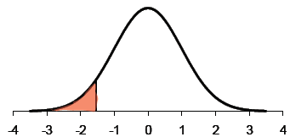

Ex Problem #3
NORMDIST(-1.68,0,1,true)=0.0465
NORMSDIST(-1.68)

Slide 28
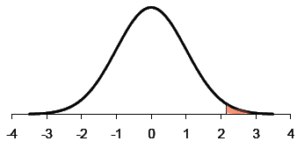

Ex Problem #4
NORMDIST(-1.68,0,1,true)=0.9825
NORMSDIST(-1.68)=0.9825
P[z>2.11]=1-0.9825

Slide 29
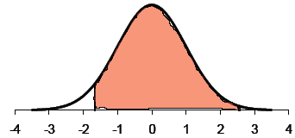

Ex Problem #5

Slide 30
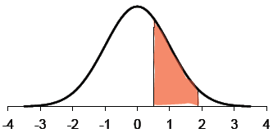

Ex Problem #6

Slide 31
Ex Problem #7
Determine the probabilities associated w/ the following ranges of Z-values:
P [ Z ≤ 0.52 ] =
P [−2.09 ≤ Z ≤ +1.87] =
P [ Z ≥ 2.18] =
P [0.12 ≤ Z ≤ 2.34] =
P [ Z ≤ -4] =
0.6985
0.9510 (0.9693 – 0.0183)
0.0146 (1 – 0.9854)
0.4426 (0.9904 – 0.5478)
3.16 x 10⁻⁵

Slide 32
Inverse functions in excel
NORMSINV
NORM.S.INV
Returns the inverse of the cumulative normal standard distribution
Enter probability, it returns z

Slide 33
Determine the values for z_{i} that fulfill the following probability statements:
z_{i} = -1.96
P [ Z ≤ z_{i} ] = 0.025

Slide 34
Determine the values for z_{i} that fulfill the following probability statements:
P [ Z ≥ z_{i} ] = 0.025=1-0.025=0.975
z_{i} = 1.96
=NORMSINV(0.975)

Slide 35
Ex Problem #7
Determine the values for z_{i} that fulfill the following probability statements:
P [ Z ≥ z_{i} ] = 0.05 z_{i} =
P [ Z ≤ z_{i} ] = 0.5 z_{i} =
P [ Z ≤ z_{i} ] = 0.95 z_{i} =
P [ Z ≥ z_{i} ] = 0.80 z_{i} =
+1.645
0
+1.645
−0.845

Slide 36
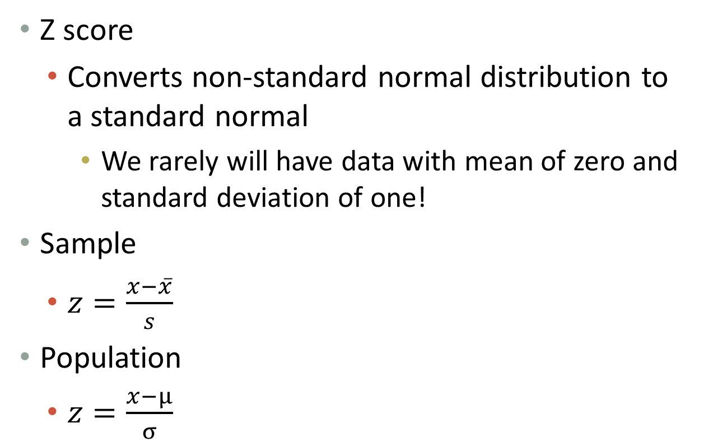
Z-statistic
Z score
Converts non-standard normal distribution to a standard normal
We rarely will have data with mean of zero and standard deviation of one!
Sample
$z=\frac{x−\overline{x}}{s}$
Population
$z=\frac{x−µ}{σ}$

Slide 37
What does the Z-statistic mean?
The number of standard deviations that a given value x is above or below the mean
Whenever a value is less than the mean, its corresponding z score is negative

Slide 38
P-value
P value is the probability of getting a value of the test statistic that is at least as extreme as the one representing the sample data.

Slide 39
Practice z-conversion with heart rate data
Using bpm data
1. calculate mean and standard deviation
2. arrange data low to high
3. convert bpm to z-values
4. what is probability of guinea pig with bpm < 60
5. what is probability of guinea pig with bpm > 75.8
What proportion of guinea pigs have heart rates between 63.1 and 91.4
8. What is the range of heart rates for 68% of guinea pigs?

Slide 40
 |  |  | Cummulative | Distribution
bpm | sorted | z scores | probability | function
 | bpm |  | NORMSDIST(z) | NORM.S.DIST(z,FALSE)
80.7 | 45.0 | -3.05915 | 0.001110 | 0.003705
56.3 | 45.0 | -3.05915 | 0.001110 | 0.003705
83.5 | 45.0 | -3.05915 | 0.001110 | 0.003705
79.0 | 48.0 | -2.76796 | 0.002820 | 0.008654
93.6 | 52.5 | -2.33117 | 0.009872 | 0.026355
81.4 | 56.3 | -1.96229 | 0.024864 | 0.058179
67.5 | 57.3 | -1.86253 | 0.031264 | 0.070408
64.5 | 58.4 | -1.75461 | 0.039663 | 0.085583
75.8 | 58.5 | -1.74879 | 0.040164 | 0.086461
72.1 | 58.5 | -1.74879 | 0.040164 | 0.086461
57.3 | 58.6 | -1.73482 | 0.041386 | 0.088590
91.5 | 59.1 | -1.68845 | 0.045663 | 0.095908
82.8 | 59.9 | -1.61414 | 0.053249 | 0.108429
78.1 | 60.0 | -1.60319 | 0.054446 | 0.110355
90.6 | 60.4 | -1.56232 | 0.059106 | 0.117729
80.1 | 63.0 | -1.312 | 0.094760 | 0.168704
63.1 | 63.0 | -1.312 | 0.094760 | 0.168704
74.4 | 63.1 | -1.3071 | 0.095589 | 0.169789
77.8 | 63.1 | -1.30037 | 0.096737 | 0.171285
82.1 | 64.5 | -1.16659 | 0.121688 | 0.202016
71.2 | 64.5 | -1.1664 | 0.121726 | 0.202061

Slide 41
Next time
Hypothesis testing
Sampling distribution

